Slide 1
Bonners Ferry Slide, 1998
In mid-October of 1998, a section of hillside north of Bonners Ferry, Idaho, moved in response to gravity, wiping out a portion of HW95, the railway and powerlines. See the damage for yourself in the following photos!

Slide 2
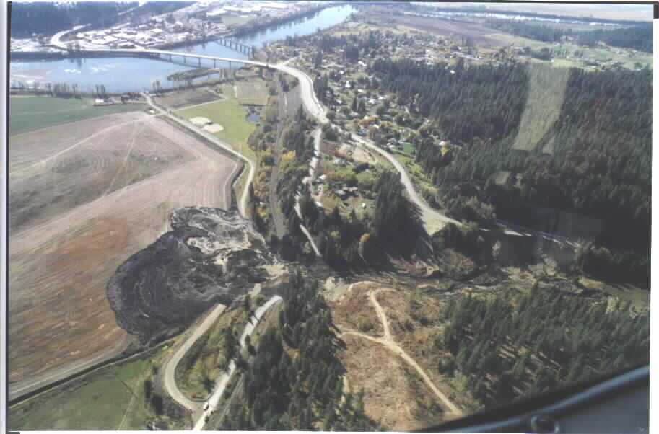
Aerial View of the Slide Area

Slide 3
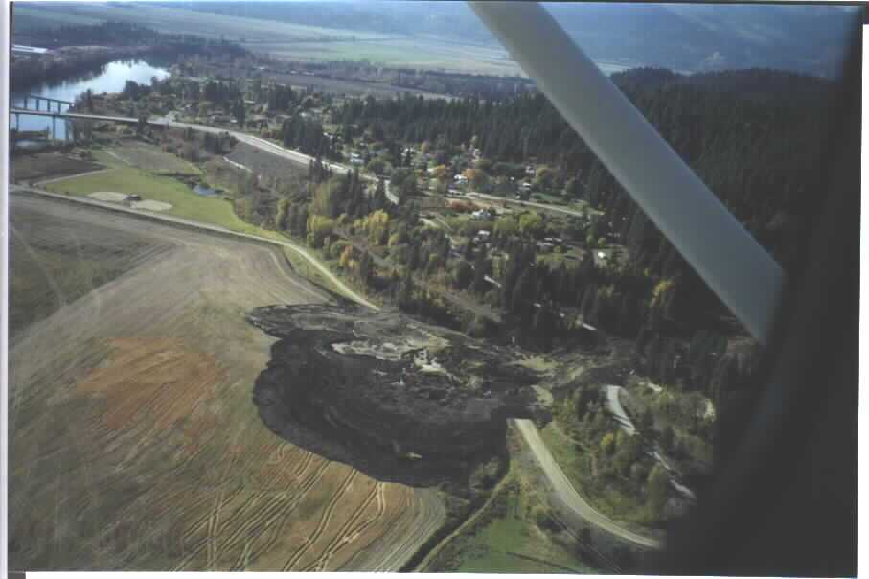

Slide 4
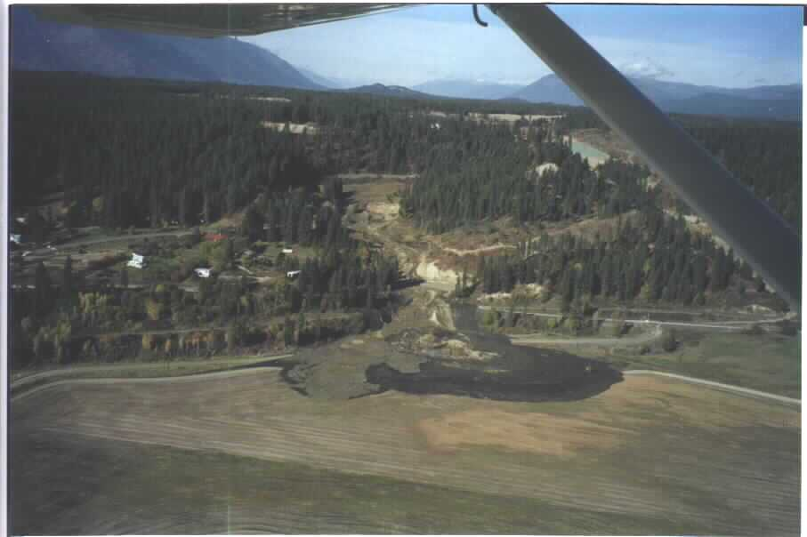
Looking from the East

Slide 5
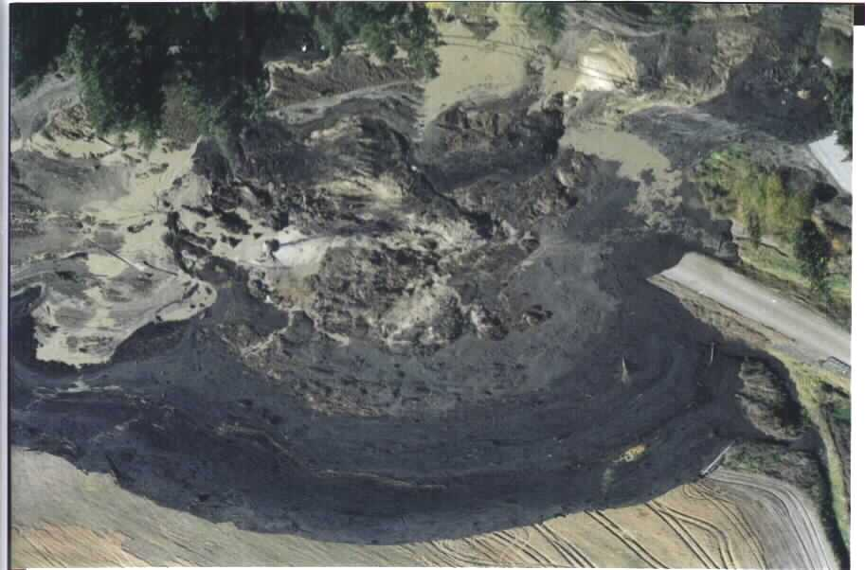

Slide 6
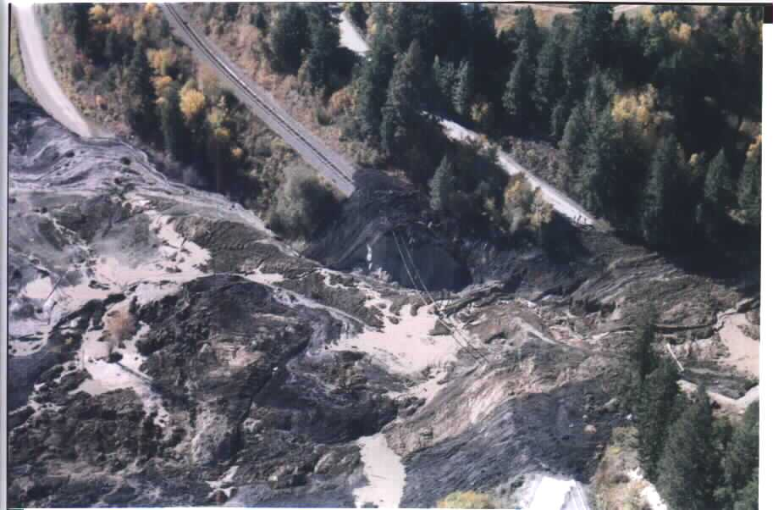

Slide 7
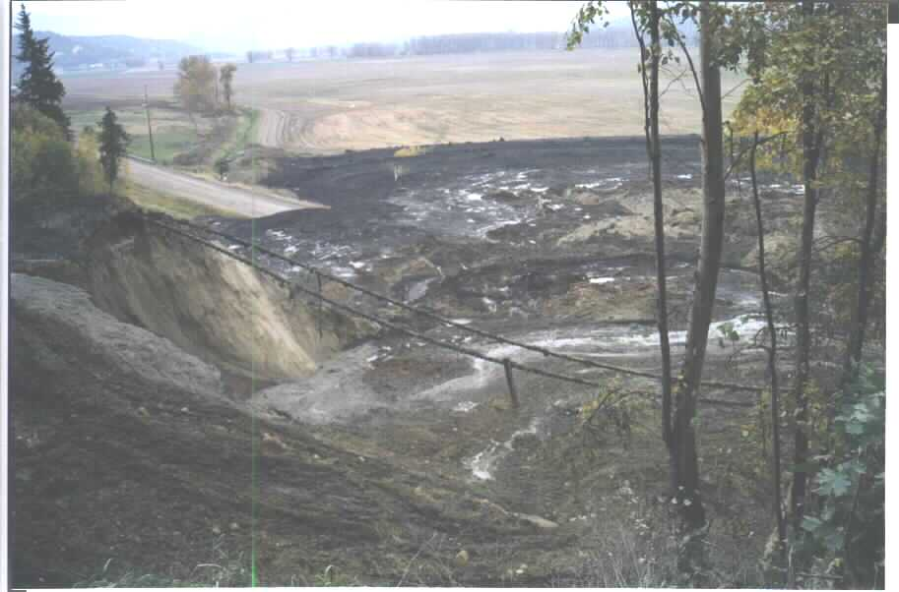
Railroad rails and hanging tie

Slide 8
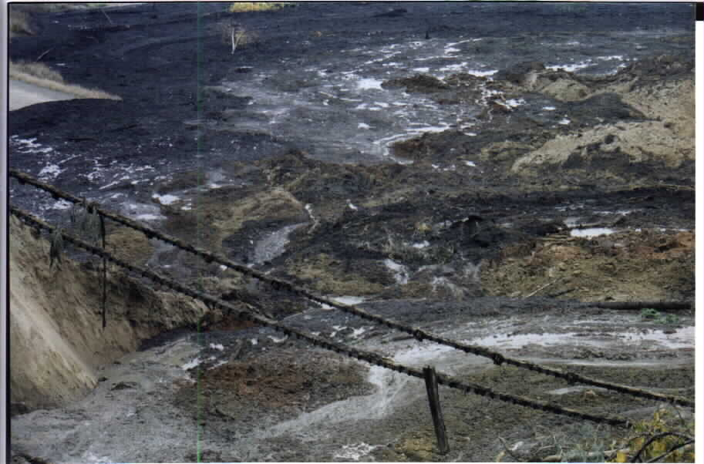
Rails and hanging tie from railroad

Slide 9
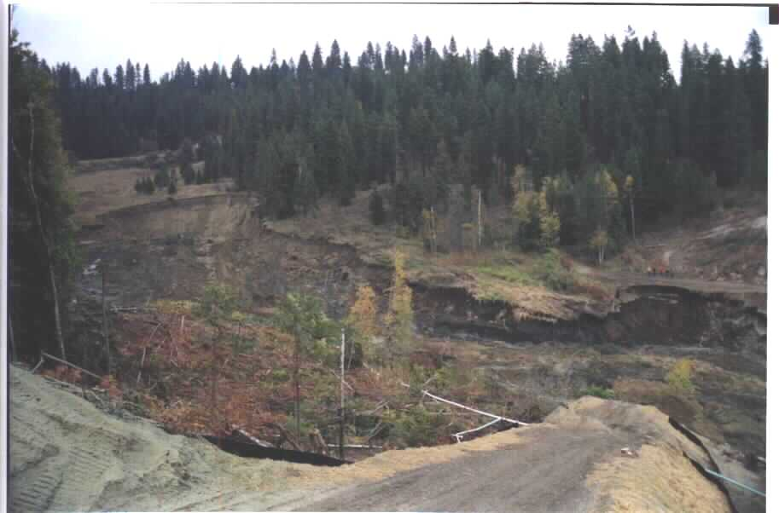
Looking from the South

Slide 10
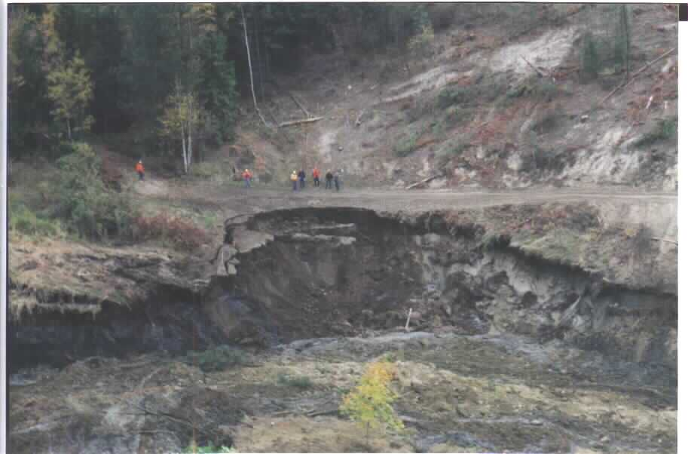
Looking from the North

Slide 11
Write your evaluation
What type of mass wasting occurred here?
List and defend your evaluation of this event.
Type it out and hand it in for scoring.
The desired response is on the last slide

Slide 12
The Bonners Ferry slide was a major mudflow (as evidenced in slides 2-8) followed by slump (slides 9-10)

